Slide 1

U.S. Airline comparisons
Adrianna, Kaushik & Marissa

Slide 2

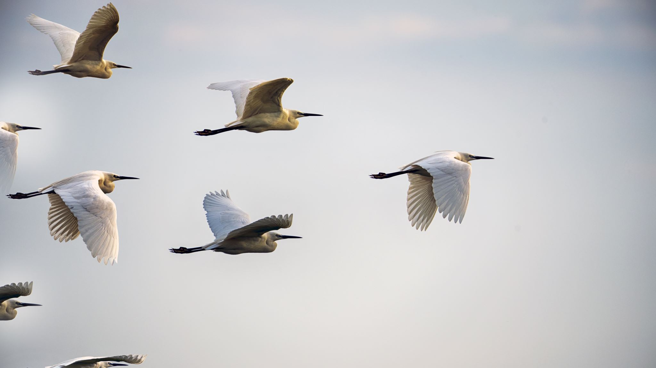
Hypothesis:
Flights with less cancellations, delays and diversions have a direct impact on consumer satisfaction.

Slide 3

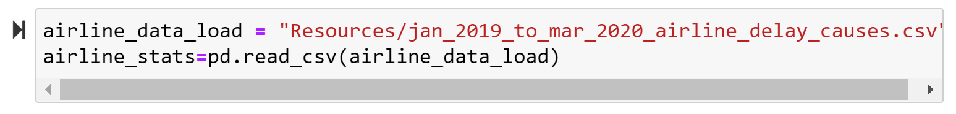
Load Data:
(Left) Scraped consumer satisfaction scores from the web.
(Right) Loaded in a CSV

Slide 4
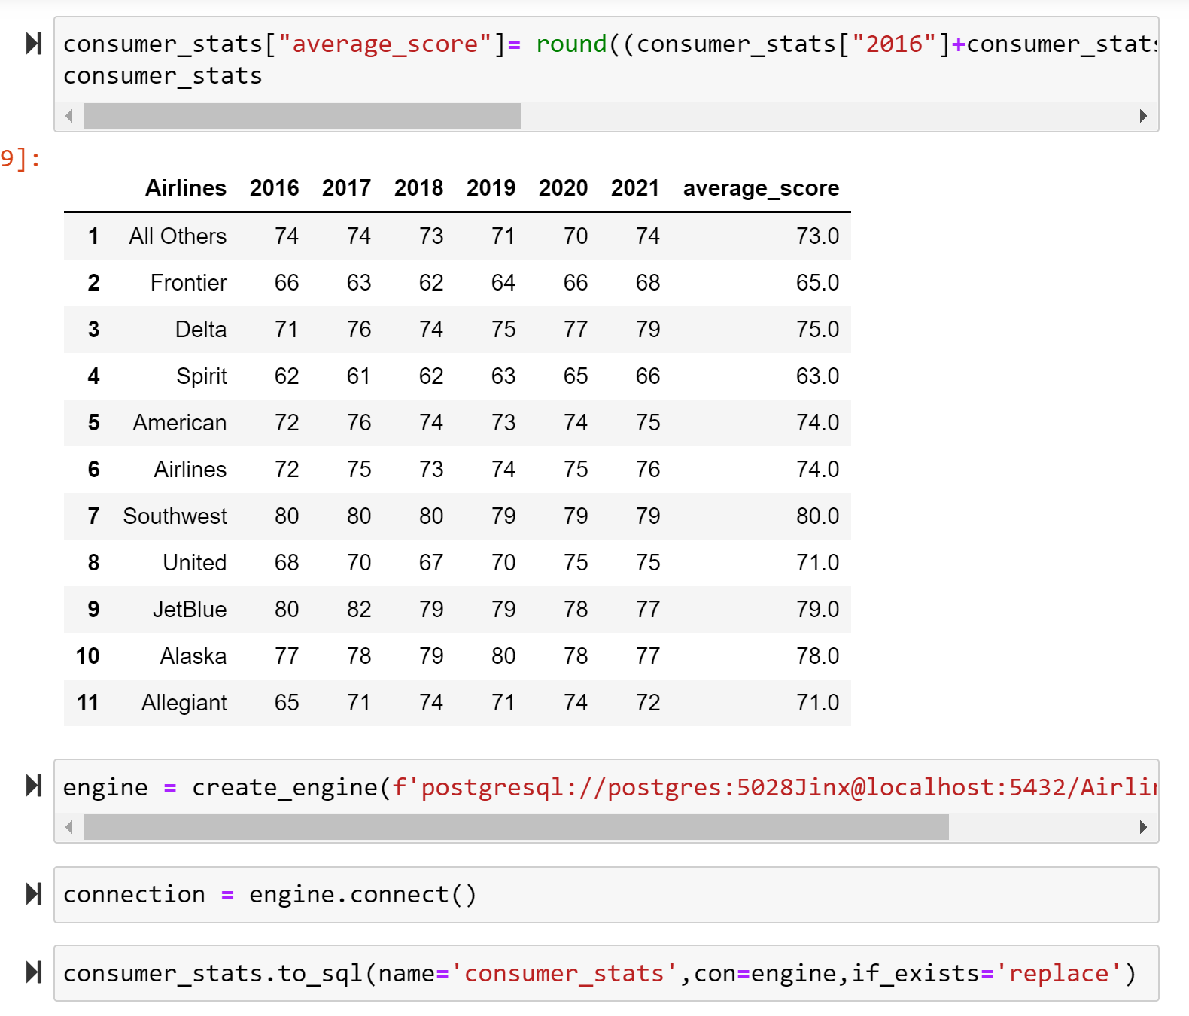
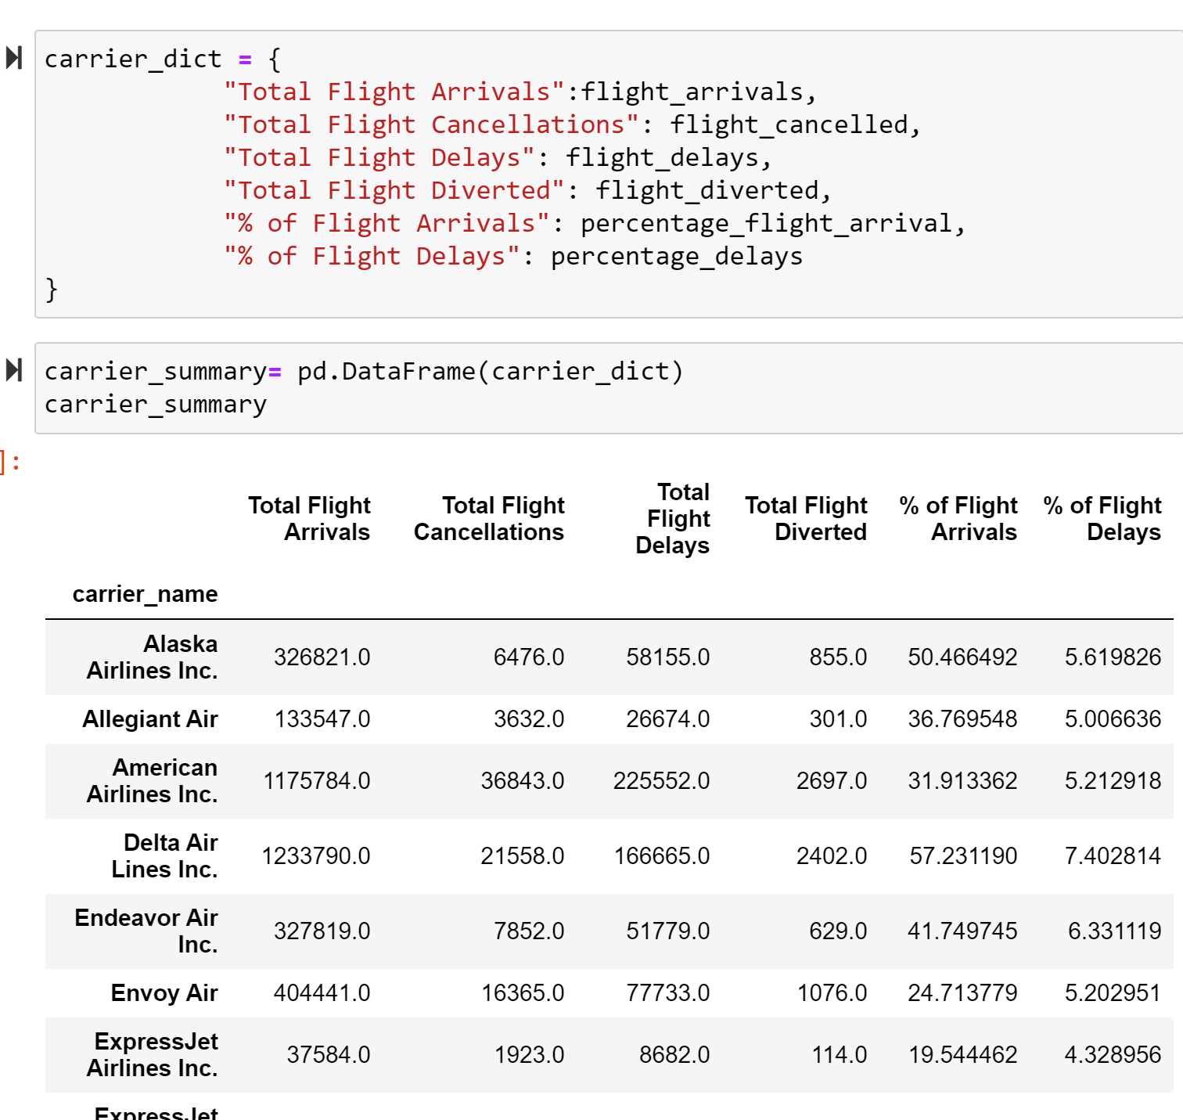
Transform Data:

Slide 5
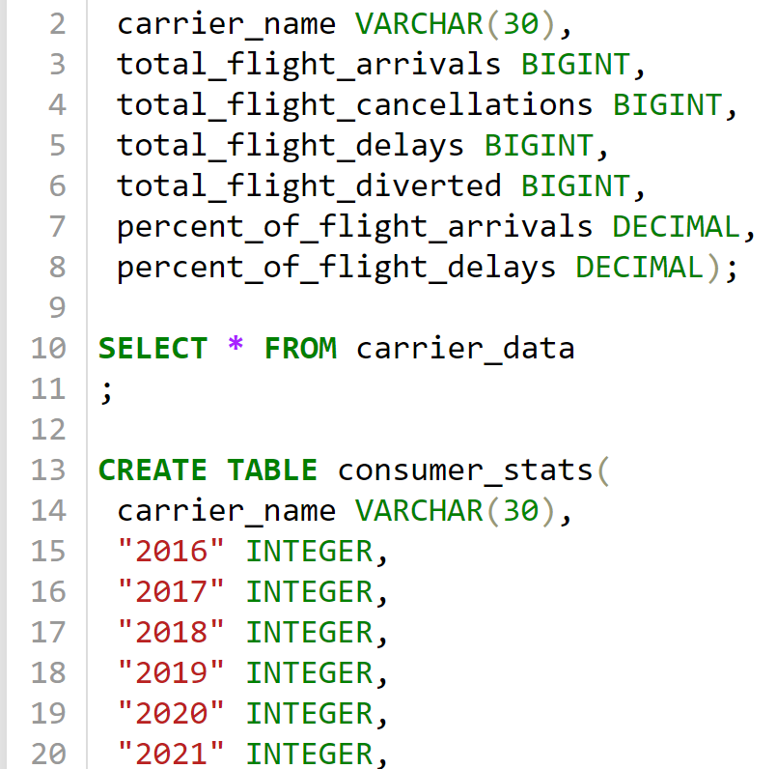
SQL Table Creation

Slide 6
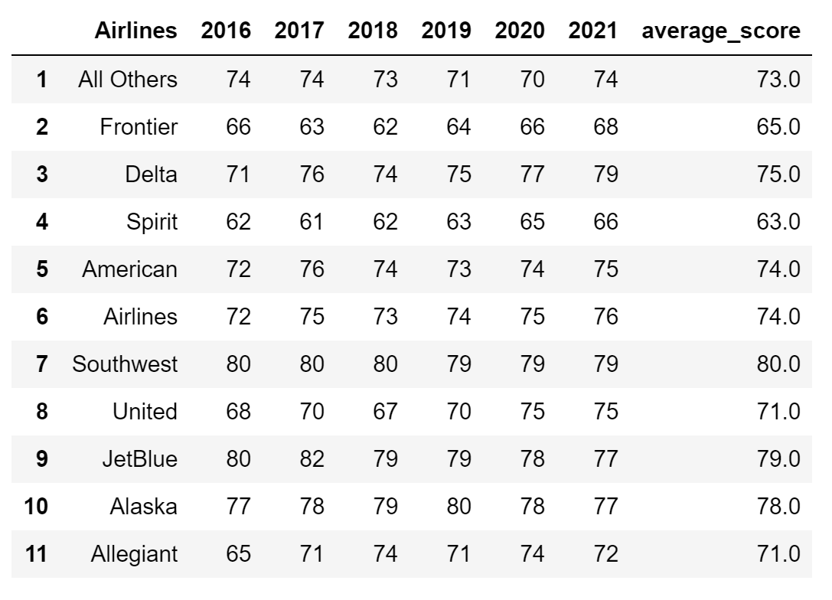
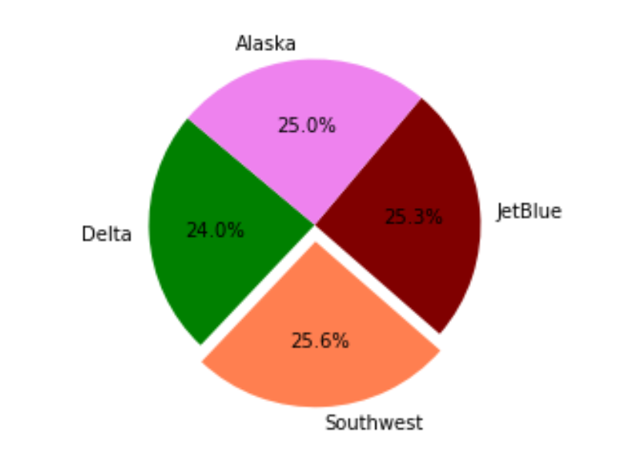
Findings:
Consumer Scores Per Airline and Average 6yr Score
Airlines with an Average Score of 75% & Above

Slide 7
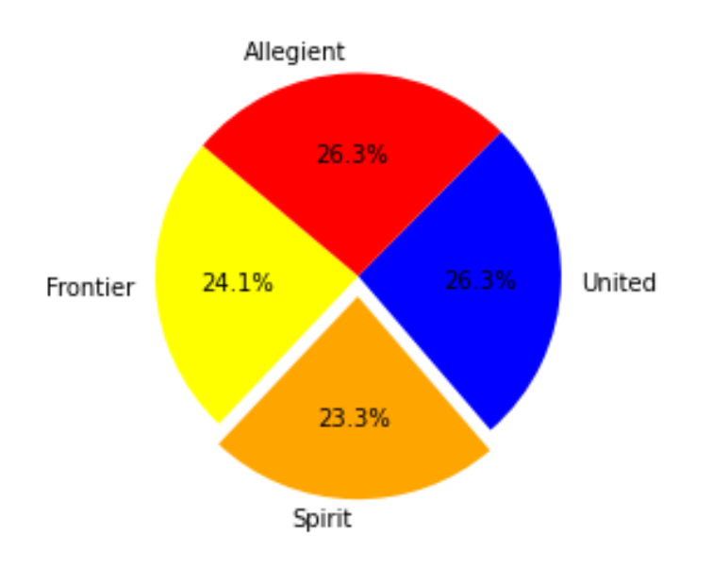
Consumer Scores Per Airline and Average 6yr Score
Airlines with an Average Score of 71% & Below

Slide 8

Carrier Data from 2019 to 2021: Delays, Cancellations, Diversions and Arrivals.

Slide 9
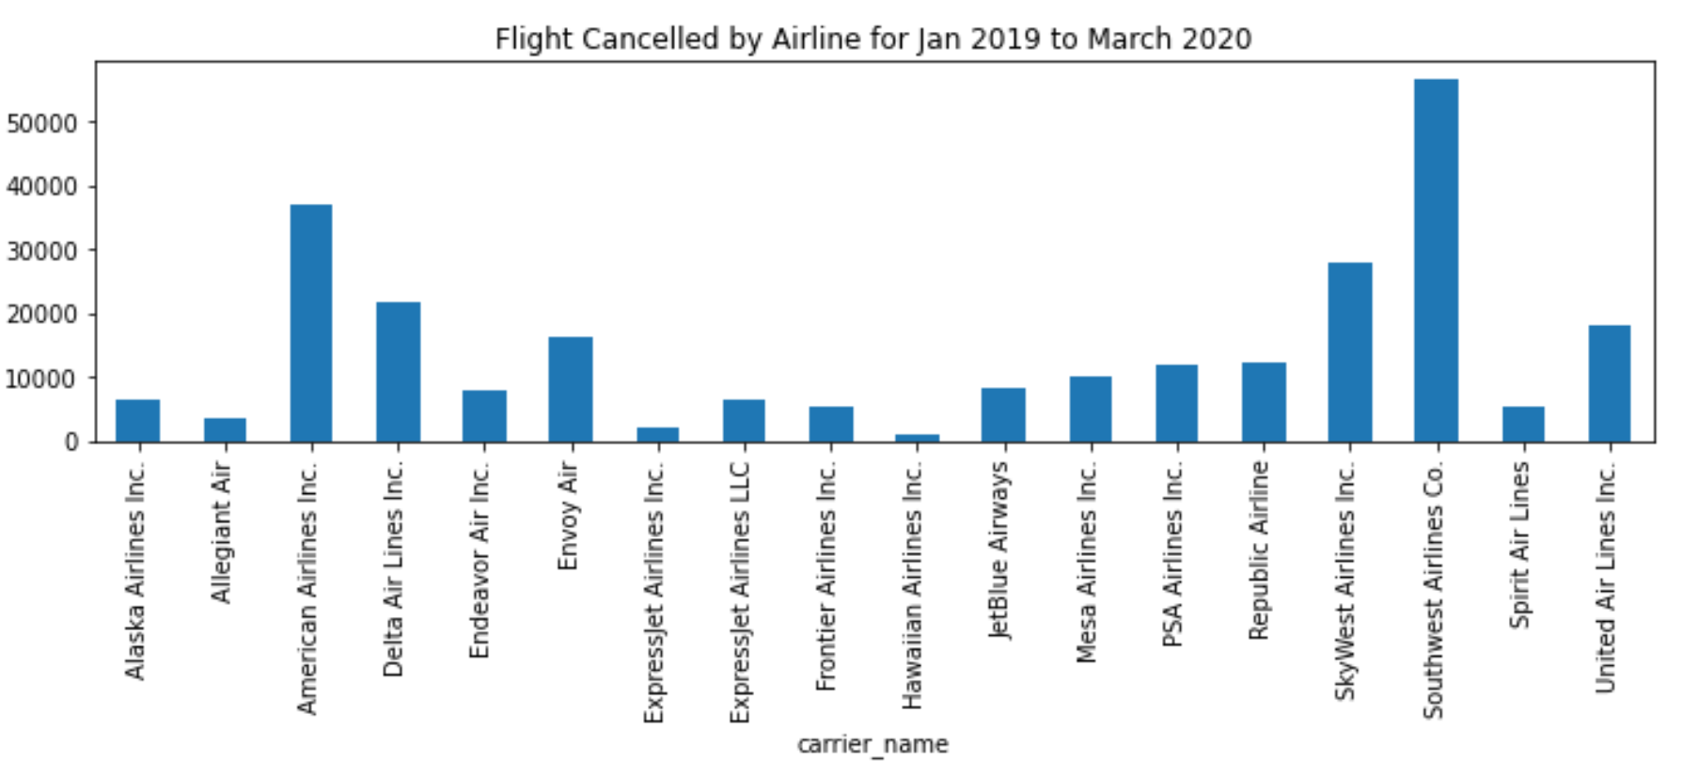
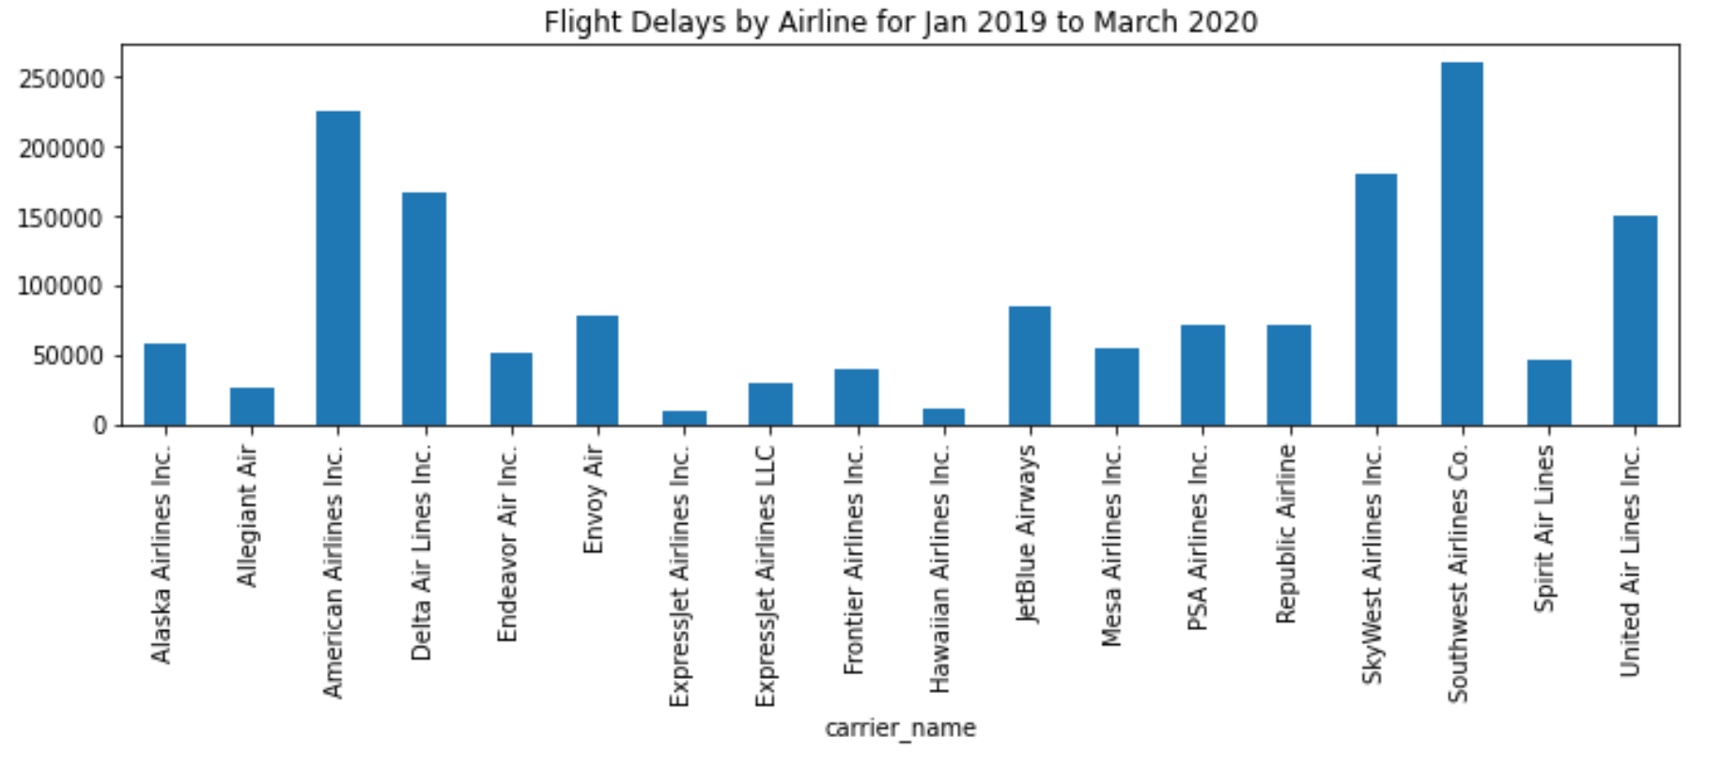
Southwest Airlines has the highest numbers in cancellations and delays, yet maintains a high consumer approval.

Slide 10
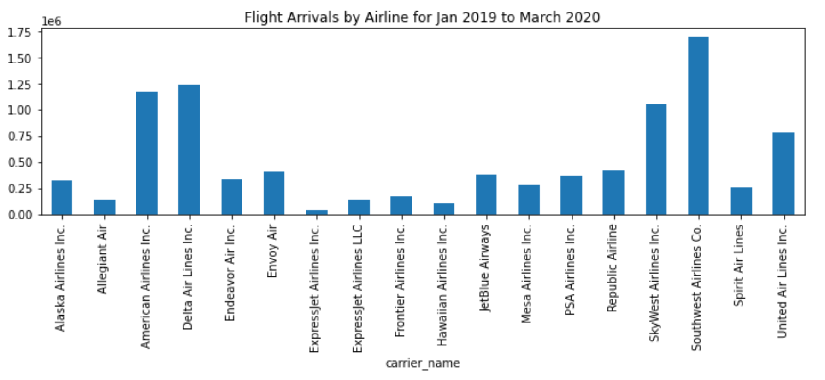
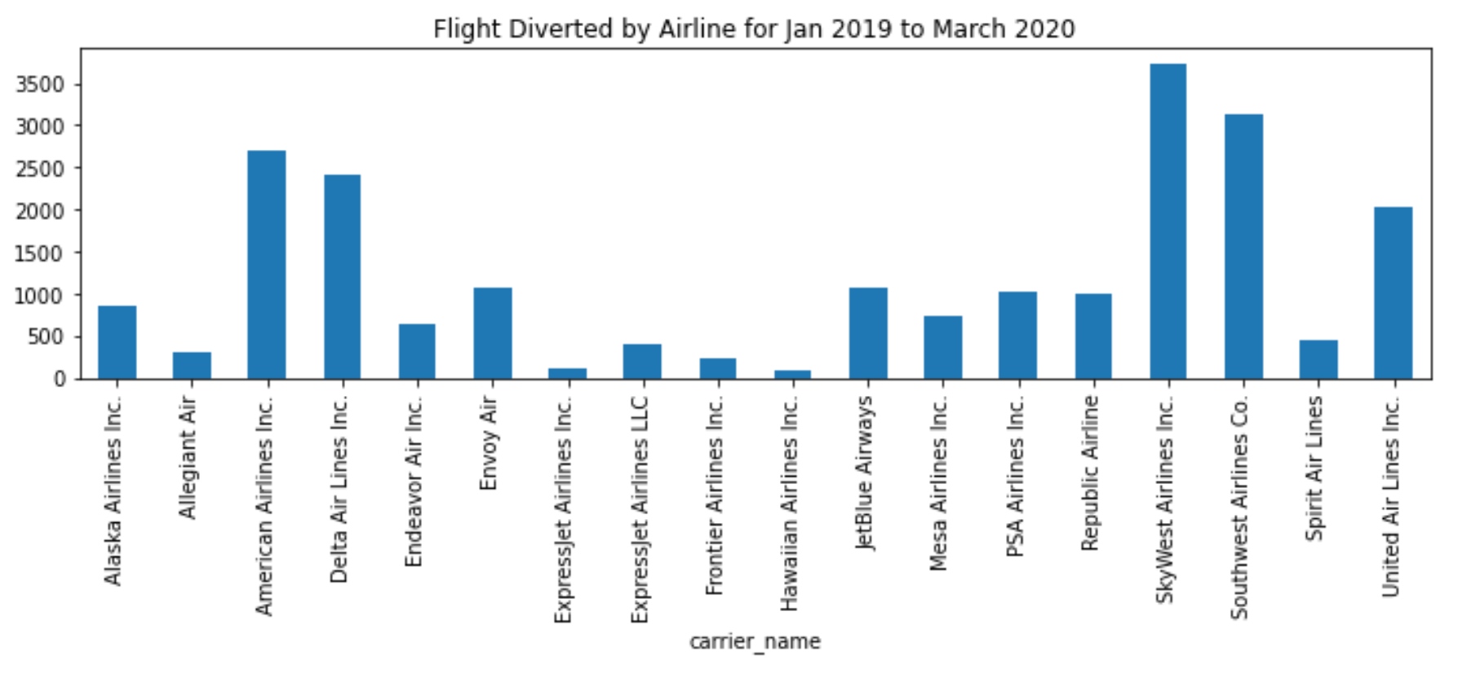
Southwest Airlines has the highest numbers in arrivals and second highest in diversions, yet maintains a high consumer approval.

Slide 11
Conclusion:
It seems that delays, cancellations and diversions do not have a large impact on customer approval.
Seemingly, the treatment of your customers are what keeps you on top. For Southwest the factors that keep the company with the highest ratings are:
2 free checked bags
Low fare rates
Friendly staff
Free food

Slide 12
Sources:
https://www.theacsi.org/index.php?option=com_content&view=article&id=149&catid=&Itemid=212&i=Airlines&sort=ChangeAnual
Aviation Data & Statistics (faa.gov)
5 Reasons Why Southwest Airlines Is The Best (theodysseyonline.com)

